Slide 1
CS2100 Tutorial 9
Song Kai
song.kai@nus.edu.sg

Slide 2
1. Introduction (1/2)
Two classes of logic circuits
Combinational
Sequential
Combinational Circuit
Each output depends entirely on the immediate (present) inputs.
Sequential Circuit
Each output depends on both present inputs and state.
Combinational
Logic
Combinational
Logic
inputs
: :
: :
outputs
inputs
: :
: :
outputs
Memory

Slide 3
2. Memory Elements (3/3)
Two types of triggering/activation
Pulse-triggered
Edge-triggered
Pulse-triggered
Latches
ON = 1, OFF = 0
Edge-triggered
Flip-flops
Positive edge-triggered (ON = from 0 to 1; OFF = other time)
Negative edge-triggered (ON = from 1 to 0; OFF = other time)
Positive pulses
Positive edges
Negative edges

Slide 4
3.1 S-R Latch
S
R
Q
Q'
Characteristic table for active-high input S-R latch:
Q(t+1) = ?
S + R'∙Q
S∙R = 0

Notes:
set, reset

Slide 5
3.1 Gated S-R Latch
S-R latch + enable input (EN) and 2 NAND gates → a gated S-R latch.
S
Q
S
EN
R
Q
Q'
EN
Q'
R
Outputs change (if necessary) only when EN is high.
Notes:
It can be 1-enable or 0-enable. In the diagram we have an 1-enable.

Slide 6
4. Flip-flops (FF)
Positive pulses
S-R flip-flop, D flip-flop, and J-K flip-flop.
Note the “>” symbol at the clock input.
Positive edges
Negative edges
S
C
R
Q
Q'
D
C
Q
Q'
J
C
K
Q
Q'
Positive edge-triggered flip-flops
S
C
R
Q
Q'
D
C
Q
Q'
J
C
K
Q
Q'
Negative edge-triggered flip-flops

Slide 7
4.1 S-R Flip-flop
S-R for set-reset
S-R flip-flop: On the triggering edge of the clock pulse,
R = HIGH and S = LOW ➔ Q becomes LOW (RESET state)
S = HIGH and R = LOW ➔ Q becomes HIGH (SET state)
Both R and S are LOW ➔No change in output Q
Both R and S are HIGH ➔Invalid!
Characteristic table of positive edge-triggered S-R flip-flop:
S
C
R
Q
Q'
X = irrelevant (“don't care”)
↑ = clock transition LOW to HIGH
Notes:
set reset

Slide 8
4.2 D Flip-flop
D for Data or Delay
Handling data
Delay the data change to synchronize with the clock
D flip-flop: Single input D (data). On the triggering edge of the clock pulse,
D = HIGH ➔ Q becomes HIGH (SET state)
D = LOW ➔ Q becomes LOW (RESET state)
Hence, Q “follows” D at the clock edge.
Convert S-R flip-flop into a D flip-flop: add an inverter.
D
S
C
R
Q
Q'
CLK
A positive edge-triggered D flip-flop formed with an S-R flip-flop.
↑ = clock transition LOW to HIGH

Slide 9
4.3 J-K Flip-flop
Invented by Jack Kilby
J-K flip-flop circuit:
J
Q
Pulse transition detector
CLK
Q'
K
Characteristic table:
Q(t+1) = ?
J∙Q' + K'∙Q


Slide 10
4.4 T Flip-flop
T for toggle
T flip-flop: Single input version of the J-K flip-flop, formed by tying both inputs together.
T
T
Q
J
C
K
Q
Q'
Pulse transition detector
CLK
CLK
Q'
Characteristic table:
Q(t+1) = ?
T∙Q' + T'∙Q


Slide 11
5. Asynchronous Inputs (2/2)
A J-K flip-flop with active-low PRESET and CLEAR asynchronous inputs.
PRE
PRE
J
Q
J
C
K
Q
Q'
Pulse transition detector
CLK
K
Q'
CLR
CLR
CLK
PRE
CLR
J = K = HIGH
Q
Preset
Toggle
Clear
Notes:
We use active low here: when PRESET is 0, the output is always 1; when CLEAR is 0, the output is always 0. They cannot be both zero, but can be both one.

Slide 12
6.1 Flip-flop Characteristic Tables
Each type of flip-flop has its own behaviour, shown by its characteristic table.

Slide 13
6.2 Sequential Circuits: Analysis
Example using D flip-flops
x
D
Q
A
State equations:
A⁺ = A∙x + B∙x
B⁺ = A'∙x
Output function:
y = (A + B)∙x'
Q'
A'
D
Q
B
Q'
B'
CP
y
Figure 1

Slide 14
6.2 Sequential Circuits: Analysis
State table for circuit of Figure 1:
State equations:
A⁺ = A∙x + B∙x
B⁺ = A'∙x
Output function:
y = (A + B)∙x'

Slide 15
6.2 Sequential Circuits: Analysis
State diagram of the circuit of Figure 1:
0/0
1/0
0/1
00
10
1/0
0/1
0/1
1/0
DONE!
01
1/0
11
Notes:
We use x / y to indicate the input / output

Slide 16
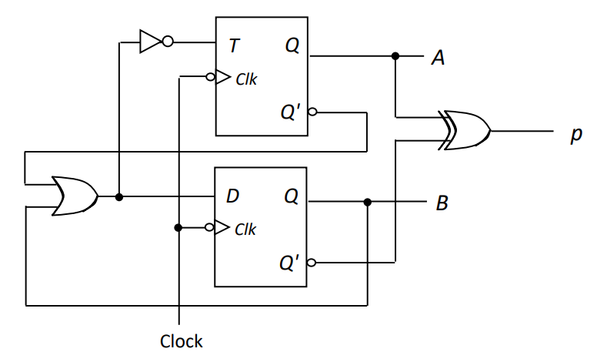
Q1 Circuit Analysis – T & D Flip-Flops
(A’+B)’= A∙B'
A'
A⊕B'
A'+B
B'

Slide 17
Q1 Circuit Analysis – T & D Flip-Flops
Present State |  | Output | Flip-flop inputs |  | Next State
A | B | P = A⊕B' | TA = A∙B' | DB = A'+B | A⁺ | B⁺
0 | 0 | 1 | 0 | 1
0 | 1 | 0 | 0 | 1
1 | 0 | 0 | 1 | 0
1 | 1 | 1 | 0 | 1

Slide 18
Q1 Circuit Analysis – T & D Flip-Flops
Present State |  | Output | Flip-flop inputs |  | Next State
A | B | P = A⊕B' | TA = A∙B' | DB = A'+B | A⁺ | B⁺
0 | 0 | 1 | 0 | 1 | 0
0 | 1 | 0 | 0 | 1 | 0
1 | 0 | 0 | 1 | 0 | 0
1 | 1 | 1 | 0 | 1 | 1

Slide 19
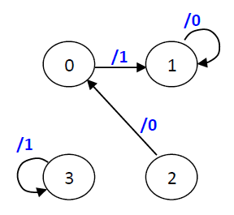
Q1 Circuit Analysis – T & D Flip-Flops
Present State |  | Output | Flip-flop inputs |  | Next State
A | B | P = A⊕B' | TA = A∙B' | DB = A'+B | A⁺ | B⁺
0 | 0 | 1 | 0 | 1 | 0 | 1
0 | 1 | 0 | 0 | 1 | 0 | 1
1 | 0 | 0 | 1 | 0 | 0 | 0
1 | 1 | 1 | 0 | 1 | 1 | 1

Slide 20
Q1 Circuit Analysis – T & D Flip-Flops
Cycle | Cycle 1 | Cycle 2 | Cycle 3
State | 00 | 01 | 01
Output | 1 | 0 | 0
After 3 clock cycles, we are at state 1, with output 100.
No. of sinks?
2 sinks: State 1 & 3
Unused state?
State 3

Slide 21
6.4 Sequential Circuits: Design
Design procedure:
Start with circuit specifications – description of circuit behaviour, usually a state diagram or state table.
Derive the state table.
Perform state reduction if necessary.
Perform state assignment.
Determine number of flip-flops and label them.
Choose the type of flip-flop to be used.
Derive circuit excitation and output tables from the state table.
Derive circuit output functions and flip-flop input functions.
Draw the logic diagram.

Slide 22
6.3 Flip-flop Excitation Tables (1/2)
Excitation tables: given the required transition from present state to next state, determine the flip-flop input(s).
characteristic table of JK Flip-flop
JK Flip-flop
SR Flip-flop
D Flip-flop
T Flip-flop
Notes:
Given the transition from Q to Q+, what is the required flip-flop inputs to make it happen?

Slide 23
6.4 Design: Example #1 (1/5)
Given the following state diagram, design the sequential circuit using JK flip-flops.
0
00
1
1
1
01
11
0
Two flip-flops. Let's call them A and B.
One input variable. Let's call it x.
0
1
10
0


Slide 24
6.4 Design: Example #1 (2/5)
Circuit state/excitation table, using JK flip-flops.
0
00
1
1
1
01
11
0
0
1
10
0
0 X
0 X
1 X
X 1
X 0
0 X
1 X
X 0
X 1
0 X
1 X
0 X
X 0
JK Flip-flop's
excitation table.
X 0
X 0
X 1


Slide 25
6.4 Design: Example #1 (4/5)
From state table, get flip-flop input functions.
Bx
B
A
00 01 11 10
0
1
1
A
X
X
X
X
x
JA = B∙x'
Bx
B
A
00 01 11 10
B
B
0
1
X
X
X
X
Bx
Bx
A
00 01 11 10
A
00 01 11 10
A
1
0
1
1
X
X
0
1
X
X
1
x
A
1
X
X
A
X
X
1
KA = B∙x
x
x
JB = x
KB = (A ⊕ x)'

Slide 26
6.4 Design: Example #1 (5/5)
Flip-flop input functions:
JA = B∙x' JB = x
KA = B∙x KB = (A ⊕ x)'
Logic diagram:
A
B
Q'
Q
Q'
Q
K
J
K
J
CP
x
With the flip-flop input functions,
we can derive the actual values for all the don’t-care terms and complete the truth table and state diagram.

Slide 27
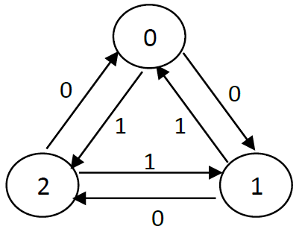
Q2 Circuit Design – JK Flip-Flops
Present State |  | Input | Next State |  | Flip-flop A |  | Flip-flop B
A | B | x | A⁺ | B⁺ | JA | KA | JB | KB
0 | 0 | 0
0 | 0 | 1
0 | 1 | 0
0 | 1 | 1
1 | 0 | 0
1 | 0 | 1
1 | 1 | 0
1 | 1 | 1

Slide 28
Q2 Circuit Design – JK Flip-Flops
Present State |  | Input | Next State |  | Flip-flop A |  | Flip-flop B
A | B | x | A⁺ | B⁺ | JA | KA | JB | KB
0 | 0 | 0 | 0 | 1
0 | 0 | 1 | 1 | 0
0 | 1 | 0 | 1 | 0
0 | 1 | 1 | 0 | 0
1 | 0 | 0 | 0 | 0
1 | 0 | 1 | 0 | 1
1 | 1 | 0 | d | d
1 | 1 | 1 | d | d

Slide 29
Q2 Circuit Design – JK Flip-Flops
JK Flip-flop's
excitation table.
Present State |  | Input | Next State |  | Flip-flop A |  | Flip-flop B
A | B | x | A⁺ | B⁺ | JA | KA | JB | KB
0 | 0 | 0 | 0 | 1 | 0 | d
0 | 0 | 1 | 1 | 0 | 1 | d
0 | 1 | 0 | 1 | 0 | 1 | d
0 | 1 | 1 | 0 | 0 | 0 | d
1 | 0 | 0 | 0 | 0 | d | 1
1 | 0 | 1 | 0 | 1 | d | 1
1 | 1 | 0 | d | d | d | d
1 | 1 | 1 | d | d | d | d

Slide 30
Q2 Circuit Design – JK Flip-Flops
JK Flip-flop's
excitation table.
Present State |  | Input | Next State |  | Flip-flop A |  | Flip-flop B
A | B | x | A⁺ | B⁺ | JA | KA | JB | KB
0 | 0 | 0 | 0 | 1 | 0 | d | 1 | d
0 | 0 | 1 | 1 | 0 | 1 | d | 0 | d
0 | 1 | 0 | 1 | 0 | 1 | d | d | 1
0 | 1 | 1 | 0 | 0 | 0 | d | d | 1
1 | 0 | 0 | 0 | 0 | d | 1 | 0 | d
1 | 0 | 1 | 0 | 1 | d | 1 | 1 | d
1 | 1 | 0 | d | d | d | d | d | d
1 | 1 | 1 | d | d | d | d | d | d

Slide 31
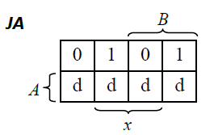
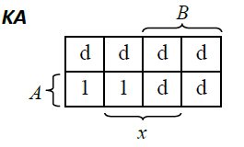
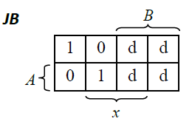
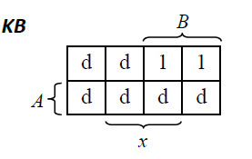
Q2 Circuit Design – JK Flip-Flops
Present State |  | Input | Flip-flop A |  | Flip-flop B
A | B | x | JA | KA | JB | KB
0 | 0 | 0 | 0 | d | 1 | d
0 | 0 | 1 | 1 | d | 0 | d
0 | 1 | 0 | 1 | d | d | 1
0 | 1 | 1 | 0 | d | d | 1
1 | 0 | 0 | d | 1 | 0 | d
1 | 0 | 1 | d | 1 | 1 | d
1 | 1 | 0 | d | d | d | d
1 | 1 | 1 | d | d | d | d

Slide 32
Q2 Circuit Design – JK Flip-Flops
JA = B∙x' + B'∙x = B ⊕ x
KA = 1
JB = A'∙x' + A∙x = A  x
KB = 1
Notes:
Fewest logic gates

Slide 33
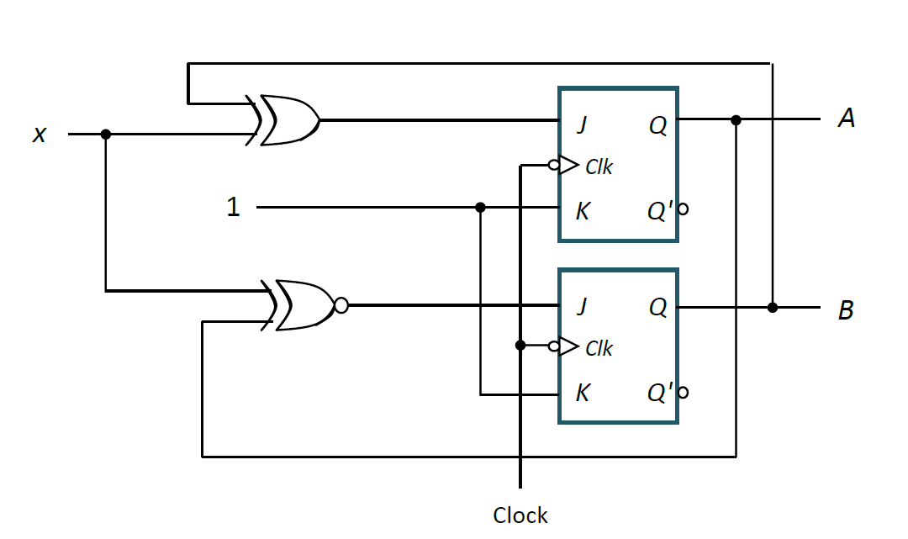
Q2 Circuit Design – JK Flip-Flops
JA = B∙x' + B'∙x = B ⊕ x
KA = 1
JB = A'∙x' + A∙x = A  x
KB = 1

Slide 34
Q2 Circuit Design – JK Flip-Flops
JA = B∙x' + B'∙x = B ⊕ x KA = 1
JB = A'∙x' + A∙x = A ʘ x KB = 1
Present State |  | Input | Next State |  | Flip-flop A |  | Flip-flop B
A | B | x | A⁺ | B⁺ | JA | KA | JB | KB
0 | 0 | 0 | 0 | 1 | 0 | d(1) | 1 | d(1)
0 | 0 | 1 | 1 | 0 | 1 | d(1) | 0 | d(1)
0 | 1 | 0 | 1 | 0 | 1 | d(1) | d(1) | 1
0 | 1 | 1 | 0 | 0 | 0 | d(1) | d(0) | 1
1 | 0 | 0 | 0 | 0 | d(0) | 1 | 0 | d(1)
1 | 0 | 1 | 0 | 1 | d(1) | 1 | 1 | d(1)
1 | 1 | 0 | d(0) | d(0) | d(1) | d(1) | d(0) | d(1)
1 | 1 | 1 | d(0) | d(0) | d(0) | d(1) | d(1) | d(1)

Slide 35
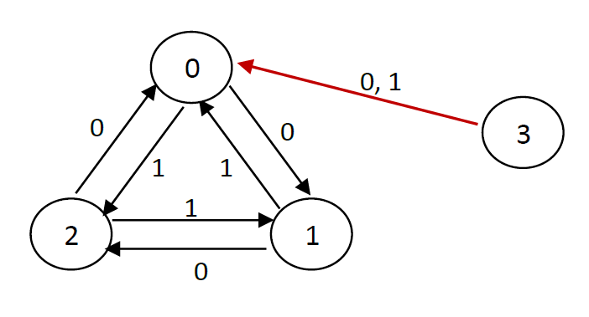
Q2 Circuit Design – JK Flip-Flops
A circuit is self-correcting if for some reason the circuit enters into any unused (invalid) state, it is able to transit to a valid state after a finite number of transitions.
JA = B∙x' + B'∙x = B ⊕ x KA = 1
JB = A'∙x' + A∙x = A  x KB = 1
Present State |  | Input | Next State |  | Flip-flop A |  | Flip-flop B
A | B | x | A⁺ | B⁺ | JA | KA | JB | KB
0 | 0 | 0 | 0 | 1 | 0 | d(1) | 1 | d(1)
0 | 0 | 1 | 1 | 0 | 1 | d(1) | 0 | d(1)
0 | 1 | 0 | 1 | 0 | 1 | d(1) | d(1) | 1
0 | 1 | 1 | 0 | 0 | 0 | d(1) | d(0) | 1
1 | 0 | 0 | 0 | 0 | d(0) | 1 | 0 | d(1)
1 | 0 | 1 | 0 | 1 | d(1) | 1 | 1 | d(1)
1 | 1 | 0 | d(0) | d(0) | d(1) | d(1) | d(0) | d(1)
1 | 1 | 1 | d(0) | d(0) | d(0) | d(1) | d(1) | d(1)
Notes:
State 3 always goes to state 0 which is a used state, regardless of input.

Slide 36
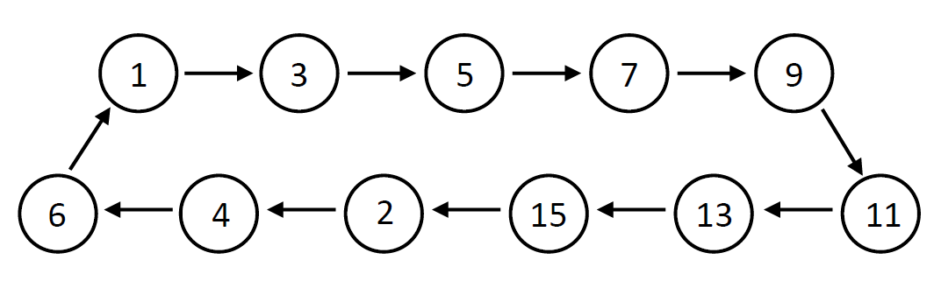
Q3 Circuit Design – All Flip-Flops
A: D flip-flop,
B, C: T flip-flops,
D: JK flip-flop

Slide 37
Q3 Circuit Design – All Flip-Flops
Current State |  |  |  | Next State
A | B | C | D | DA=A⁺ | B⁺ | C⁺ | D⁺ | TB | TC | JD | KD
0 | 0 | 0 | 0 | X | X | X | X | X | X | X | X
0 | 0 | 0 | 1
0 | 0 | 1 | 0
0 | 0 | 1 | 1
0 | 1 | 0 | 0
0 | 1 | 0 | 1
0 | 1 | 1 | 0
0 | 1 | 1 | 1
1 | 0 | 0 | 0 | X | X | X | X | X | X | X | X
1 | 0 | 0 | 1
1 | 0 | 1 | 0 | X | X | X | X | X | X | X | X
1 | 0 | 1 | 1
1 | 1 | 0 | 0 | X | X | X | X | X | X | X | X
1 | 1 | 0 | 1
1 | 1 | 1 | 0 | X | X | X | X | X | X | X | X
1 | 1 | 1 | 1
Notes:
We don’t care about state 0, and all even states after and including 8, i.e. 8, 10, 12 and 14

Slide 38
Q3 Circuit Design – All Flip-Flops
Current State |  |  |  | Next State
A | B | C | D | DA=A⁺ | B⁺ | C⁺ | D⁺ | TB | TC | JD | KD
0 | 0 | 0 | 0 | X | X | X | X | X | X | X | X
0 | 0 | 0 | 1 | 0 | 0 | 1 | 1
0 | 0 | 1 | 0 | 0 | 1 | 0 | 0
0 | 0 | 1 | 1 | 0 | 1 | 0 | 1
0 | 1 | 0 | 0 | 0 | 1 | 1 | 0
0 | 1 | 0 | 1 | 0 | 1 | 1 | 1
0 | 1 | 1 | 0 | 0 | 0 | 0 | 1
0 | 1 | 1 | 1 | 1 | 0 | 0 | 1
1 | 0 | 0 | 0 | X | X | X | X | X | X | X | X
1 | 0 | 0 | 1 | 1 | 0 | 1 | 1
1 | 0 | 1 | 0 | X | X | X | X | X | X | X | X
1 | 0 | 1 | 1 | 1 | 1 | 0 | 1
1 | 1 | 0 | 0 | X | X | X | X | X | X | X | X
1 | 1 | 0 | 1 | 1 | 1 | 1 | 1
1 | 1 | 1 | 0 | X | X | X | X | X | X | X | X
1 | 1 | 1 | 1 | 0 | 0 | 1 | 0
Notes:
State 1 goes to state 3

Slide 39
Q3 Circuit Design – All Flip-Flops
Current State |  |  |  | Next State
A | B | C | D | DA=A⁺ | B⁺ | C⁺ | D⁺ | TB | TC | JD | KD
0 | 0 | 0 | 0 | X | X | X | X | X | X | X | X
0 | 0 | 0 | 1 | 0 | 0 | 1 | 1 | 0 | 1 | X | 0
0 | 0 | 1 | 0 | 0 | 1 | 0 | 0 | 1 | 1 | 0 | X
0 | 0 | 1 | 1 | 0 | 1 | 0 | 1 | 1 | 1 | X | 0
0 | 1 | 0 | 0 | 0 | 1 | 1 | 0 | 0 | 1 | 0 | X
0 | 1 | 0 | 1 | 0 | 1 | 1 | 1 | 0 | 1 | X | 0
0 | 1 | 1 | 0 | 0 | 0 | 0 | 1 | 1 | 1 | 1 | X
0 | 1 | 1 | 1 | 1 | 0 | 0 | 1 | 1 | 1 | X | 0
1 | 0 | 0 | 0 | X | X | X | X | X | X | X | X
1 | 0 | 0 | 1 | 1 | 0 | 1 | 1 | 0 | 1 | X | 0
1 | 0 | 1 | 0 | X | X | X | X | X | X | X | X
1 | 0 | 1 | 1 | 1 | 1 | 0 | 1 | 1 | 1 | X | 0
1 | 1 | 0 | 0 | X | X | X | X | X | X | X | X
1 | 1 | 0 | 1 | 1 | 1 | 1 | 1 | 0 | 1 | X | 0
1 | 1 | 1 | 0 | X | X | X | X | X | X | X | X
1 | 1 | 1 | 1 | 0 | 0 | 1 | 0 | 1 | 0 | X | 1
D Flip-flop
T Flip-flop
JK Flip-flop

Slide 40
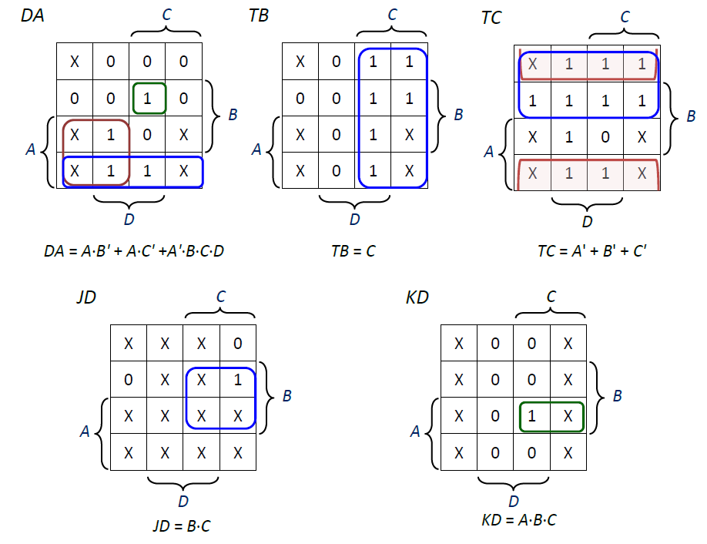
Q3 Circuit Design – All Flip-Flops
DA = A∙B' + A∙C' + A'∙B∙C∙D
TB = C
TC = A' + B' + C'
JD = B∙C
KD = A∙B∙C

Slide 41
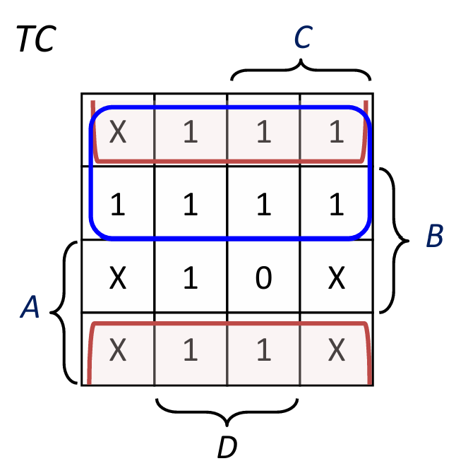
Q3 Circuit Design – All Flip-Flops
Current State |  |  |  | Next State
A | B | C | D | DA=A⁺ | B⁺ | C⁺ | D⁺ | TB | TC | JD | KD
0 | 0 | 0 | 0 | X(0) | X | X | X | X(0) | X(1) | X(0) | X(0)
0 | 0 | 0 | 1 | 0 | 0 | 1 | 1 | 0 | 1 | X | 0
0 | 0 | 1 | 0 | 0 | 1 | 0 | 0 | 1 | 1 | 0 | X
0 | 0 | 1 | 1 | 0 | 1 | 0 | 1 | 1 | 1 | X | 0
0 | 1 | 0 | 0 | 0 | 1 | 1 | 0 | 0 | 1 | 0 | X
0 | 1 | 0 | 1 | 0 | 1 | 1 | 1 | 0 | 1 | X | 0
0 | 1 | 1 | 0 | 0 | 0 | 0 | 1 | 1 | 1 | 1 | X
0 | 1 | 1 | 1 | 1 | 0 | 0 | 1 | 1 | 1 | X | 0
1 | 0 | 0 | 0 | X(1) | X | X | X | X(0) | X(1) | X(0) | X(0)
1 | 0 | 0 | 1 | 1 | 0 | 1 | 1 | 0 | 1 | X | 0
1 | 0 | 1 | 0 | X(1) | X | X | X | X(1) | X(1) | X(0) | X(0)
1 | 0 | 1 | 1 | 1 | 1 | 0 | 1 | 1 | 1 | X | 0
1 | 1 | 0 | 0 | X(1) | X | X | X | X(0) | X(1) | X(0) | X(0)
1 | 1 | 0 | 1 | 1 | 1 | 1 | 1 | 0 | 1 | X | 0
1 | 1 | 1 | 0 | X(0) | X | X | X | X(1) | X(0) | X(1) | X(1)
1 | 1 | 1 | 1 | 0 | 0 | 1 | 0 | 1 | 0 | X | 1
DA = A∙B' + A∙C' + A'∙B∙C∙D
TB = C
TC = A' + B' + C'
JD = B∙C
KD = A∙B∙C
Notes:
With the expressions, we can fill up DA, TB, TC, JD and KD.
Alternatively, we can also look at the X used in each K-map, each X used indicates an 1, otherwise it is a 0. E.g. in TC, ABCD = 0000, 1000, 1010 and 1100 are used, 1110 is ununsed.

Slide 42
Q3 Circuit Design – All Flip-Flops
Current State |  |  |  | Next State
A | B | C | D | DA=A⁺ | B⁺ | C⁺ | D⁺ | TB | TC | JD | KD
0 | 0 | 0 | 0 | X(0) | X(0) | X(1) | X(0) | X(0) | X(1) | X(0) | X(0)
0 | 0 | 0 | 1 | 0 | 0 | 1 | 1 | 0 | 1 | X | 0
0 | 0 | 1 | 0 | 0 | 1 | 0 | 0 | 1 | 1 | 0 | X
0 | 0 | 1 | 1 | 0 | 1 | 0 | 1 | 1 | 1 | X | 0
0 | 1 | 0 | 0 | 0 | 1 | 1 | 0 | 0 | 1 | 0 | X
0 | 1 | 0 | 1 | 0 | 1 | 1 | 1 | 0 | 1 | X | 0
0 | 1 | 1 | 0 | 0 | 0 | 0 | 1 | 1 | 1 | 1 | X
0 | 1 | 1 | 1 | 1 | 0 | 0 | 1 | 1 | 1 | X | 0
1 | 0 | 0 | 0 | X(1) | X(0) | X(1) | X(0) | X(0) | X(1) | X(0) | X(0)
1 | 0 | 0 | 1 | 1 | 0 | 1 | 1 | 0 | 1 | X | 0
1 | 0 | 1 | 0 | X(1) | X(1) | X(0) | X(0) | X(1) | X(1) | X(0) | X(0)
1 | 0 | 1 | 1 | 1 | 1 | 0 | 1 | 1 | 1 | X | 0
1 | 1 | 0 | 0 | X(1) | X(1) | X(1) | X(0) | X(0) | X(1) | X(0) | X(0)
1 | 1 | 0 | 1 | 1 | 1 | 1 | 1 | 0 | 1 | X | 0
1 | 1 | 1 | 0 | X(0) | X(0) | X(1) | X(1) | X(1) | X(0) | X(1) | X(1)
1 | 1 | 1 | 1 | 0 | 0 | 1 | 0 | 1 | 0 | X | 1
↑ = clock transition LOW to HIGH
Notes:
Based on the values, we can also fill up on A+, B+, C+ and D+

Slide 43
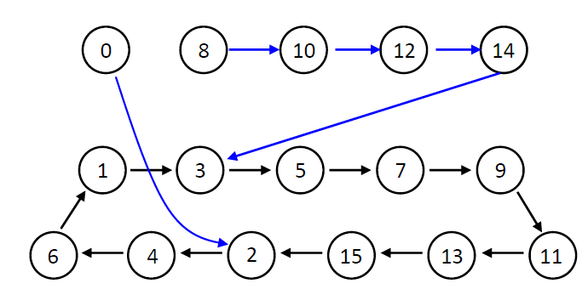
Q3 Circuit Design – All Flip-Flops
Current State |  |  |  | Next State
A | B | C | D | DA=A⁺ | B⁺ | C⁺ | D⁺
0 | 0 | 0 | 0 | X(0) | X(0) | X(1) | X(0)
0 | 0 | 0 | 1 | 0 | 0 | 1 | 1
0 | 0 | 1 | 0 | 0 | 1 | 0 | 0
0 | 0 | 1 | 1 | 0 | 1 | 0 | 1
0 | 1 | 0 | 0 | 0 | 1 | 1 | 0
0 | 1 | 0 | 1 | 0 | 1 | 1 | 1
0 | 1 | 1 | 0 | 0 | 0 | 0 | 1
0 | 1 | 1 | 1 | 1 | 0 | 0 | 1
1 | 0 | 0 | 0 | X(1) | X(0) | X(1) | X(0)
1 | 0 | 0 | 1 | 1 | 0 | 1 | 1
1 | 0 | 1 | 0 | X(1) | X(1) | X(0) | X(0)
1 | 0 | 1 | 1 | 1 | 1 | 0 | 1
1 | 1 | 0 | 0 | X(1) | X(1) | X(1) | X(0)
1 | 1 | 0 | 1 | 1 | 1 | 1 | 1
1 | 1 | 1 | 0 | X(0) | X(0) | X(1) | X(1)
1 | 1 | 1 | 1 | 0 | 0 | 1 | 0
Self-correcting!

Slide 44
Q4(a).
00
00
00
00
10
01
10
11
The circuit consists of 4 states representing the amount a visitor has deposited.
Two types of token: Pokemoney $1 (P$1) and Pokemoney $2 (P$2).
The visitor can deposit only one token at a time.
The circuit remains at state 3 when the token value exceeds 3.
The inputs x and y represent the P$1 and P$2 tokens respectively. The label on each arrow represents xy.
The left bit represents if $1 is deposited.
The right bit represents if $2 is deposited.

Slide 45
Q4(a).
00,01,10
00
00
00
10
10
10,01
00
01
10
11
01
01
The circuit consists of 4 states representing the amount a visitor has deposited.
Two types of token: Pokemoney $1 (P$1) and Pokemoney $2 (P$2).
The visitor can deposit only one token at a time.
The circuit remains at state 3 when the token value exceeds 3.
The inputs x and y represent the P$1 and P$2 tokens respectively. The label on each arrow represents xy.
The left bit represents if $1 is deposited.
The right bit represents if $2 is deposited.
Notes:
The left bit represents if $1 is deposited. The right bit represents if $2 is deposited.

Slide 46
00
00
00,01,10
Q4(b).
00
Present | B | Inputs | y | Next | B⁺
A | B | x | y | A⁺ | B⁺
0 | 0 | 0 | 0 | 0 | 0
0 | 0 | 0 | 1 | 1 | 0
0 | 0 | 1 | 0 | 0 | 1
0 | 0 | 1 | 1 | X | X
0 | 1 | 0 | 0 | 0 | 1
0 | 1 | 0 | 1 | 1 | 1
0 | 1 | 1 | 0 | 1 | 0
0 | 1 | 1 | 1 | X | X
1 | 0 | 0 | 0 | 1 | 0
1 | 0 | 0 | 1 | 1 | 1
1 | 0 | 1 | 0 | 1 | 1
1 | 0 | 1 | 1 | X | X
1 | 1 | 0 | 0 | 1 | 1
1 | 1 | 0 | 1 | 1 | 1
1 | 1 | 1 | 0 | 1 | 1
1 | 1 | 1 | 1 | X | X
00
10
01
10
10
10,01
11
01
01
DA = A⁺
x
DB = B⁺
x
0
1
X
0
0
0
X
1
0
1
X
1
1
1
X
0
B
B
1
1
X
1
1
1
X
1
A
A
1
1
X
1
0
1
X
1
y
y
DA = A + y + B⋅x
DB = B⋅x' + B'⋅x + A⋅y + A⋅x
or DB = B⋅x' + B'⋅x + A⋅y + A⋅B

Slide 47
Sequential Circuit Analysis
Obtain flip-flop inputs and circuit output (if any) expressed with the present state and input (if any).
Draw truth table.
Fill up the present state, input (if any), output (if any) and flip-flop inputs.
Obtain the next state using characteristic table.
Circuit
State Diagram
Sequential Circuit Design
Obtain flip-flop inputs from excitation table.
Get simplified expression for flip-flop inputs using K-maps.
Draw truth table.
Fill up the present state, input (if any), output (if any), the next state
Circuit
State Diagram
Obtain the next state for unused states using characteristic table.
Fill up flip-flop inputs for unused states.

Slide 48

Final Exam Instructions
Notes:
I am allowed to show you the final exam instructions.
Final is not far
Read carefully and let me know if you spot any ambiguities

Slide 49
CS2100 Tutorial 9
Song Kai
song.kai@nus.edu.sg

